Slide 1

We’re Number 1!
DSC 680 Applied Data Science
Project 3 Michael Loos
Notes:
.

Slide 2
Agenda
Background
Proposal
Data
Methods
Analysis
Conclusion

Slide 3
Background
College football rankings systems have always been a source of controversy
Multiple champions in certain years
Several different formats over the years
Polls
Bowl Championship Series (BCS)
College Football Playoff (CFP)
Can we create a better ranking system?

Slide 4
Proposal
Create a model to output ratings for each team
Use these ratings to rank each team

Slide 5
Data
2019 FBS season
Data source: collegefootballdata.com API
Weekly schedules
Variables:
School
Home/Away
Points For
Points Against
Game stats
JSON files

Slide 6
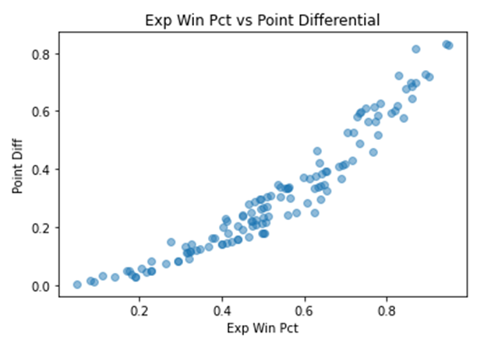
Methods
Ratings created weekly using record, points for, and points against
Colley Rankings win percentage
Uses Laplace’s rule of succession
Rating = (1 + Wins) / (2 + Games Played)
Football Outsider’s Pythagorean expected win percentage
Expected Win Percentage = Points For 2.37 / (Points For 2.37 + Points Against 2.37)
M-Score
Combines two components
M-Score = (1 + Wins) / (2 + Games Played) * Expected Win Percentage

Slide 7
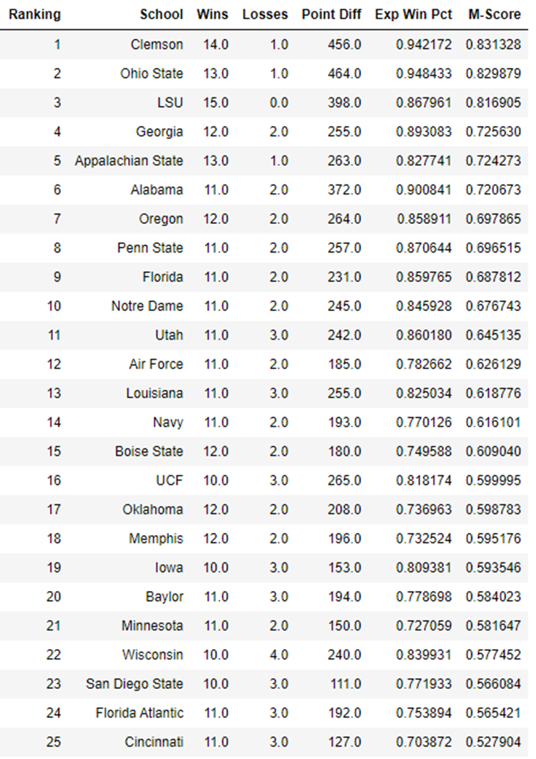
Analysis
CFP champion, LSU, finished 3rd
Appalachian State finished 5th
Average ranking of 18.5 in AP/Coaches polls
Average difference of 5 places for each team compared to AP/Coaches polls

Slide 8
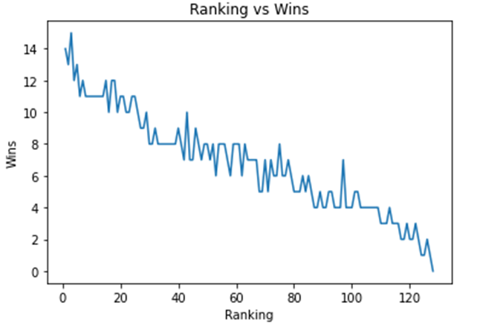
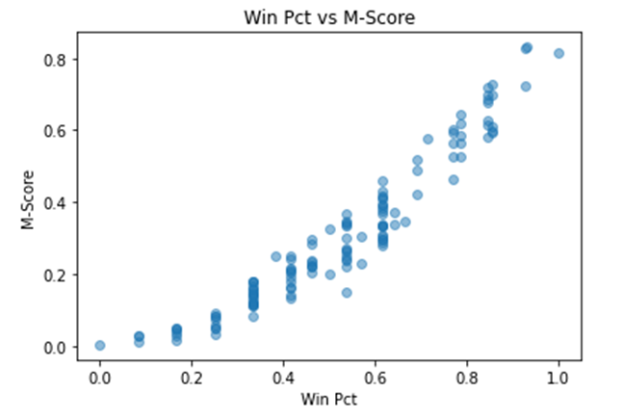
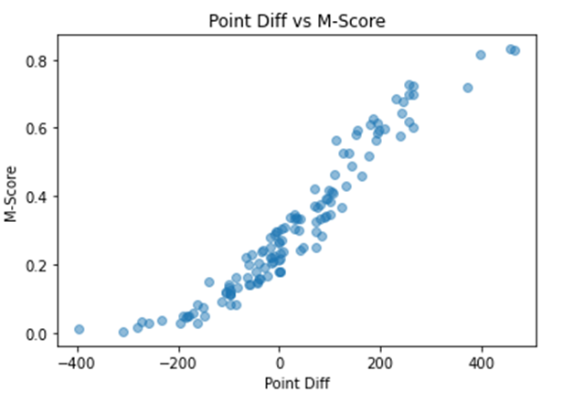
Analysis
M-Score is highly correlated with winning percentage and point differential
Expected since these are major components of the model

Slide 9
Conclusion
Model results somewhat comparable to major polls
Needs strength of schedule metric
Uses
Sole ranking system
Resource for CFP committee
Incorporated to a BCS style ranking system
Ethical issues
Intentional bias for financial purposes

